Slide 1
Collective Action in the United States (1955-1995)
Oliver Breese

Slide 2
Questions
What demographic or societal factors correlate with and influence frequency and location of demonstrations in the United States?
What is the relationship between age, gender, income, and race with likelihood to protest.
What is the relationship between the presence of violence, arrests, and deaths of the protests and the protests’ frequency?
How do the four decades covered differ in amount and type of protest?
Notes:
This analysis attempts to find factors that correlate with protests in the United States. It looks at two types of influences, demographics (age, income, education, and political party by region)), and external events like world events to determine if they have an observable impact on demonstrations.

Slide 3
This Analysis
Goals:
Finding factors and patters of protests in the U.S.
Predicting future trends
Notes:
Hopefully, the analysis will provide illuminating insight into the causes, and perhaps the effects, of protests and demonstrations. Its users should ideally be anyone with an interest in the subject, but will likely be most useful to those curious about predicting future cycles and trends in the American counterculture. It’s value is that hopefully discovering consistencies and correlations between these data points is much easier to see, which hopefully sparks more detailed research into individual trends that I, as a beginner in this subject and only a single student with little to no resources at my disposal, could not conduct

Slide 4

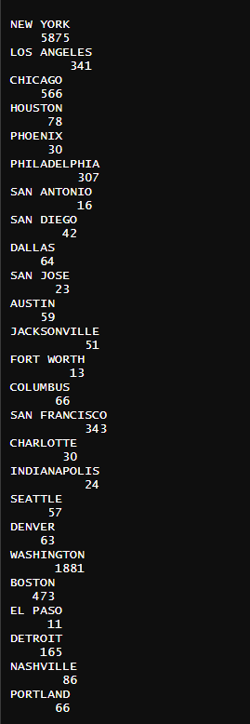
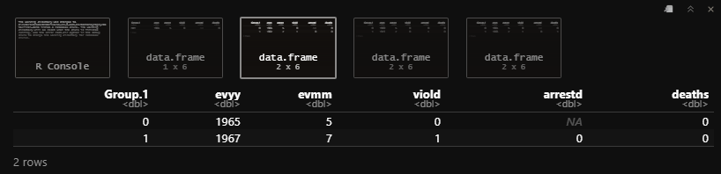
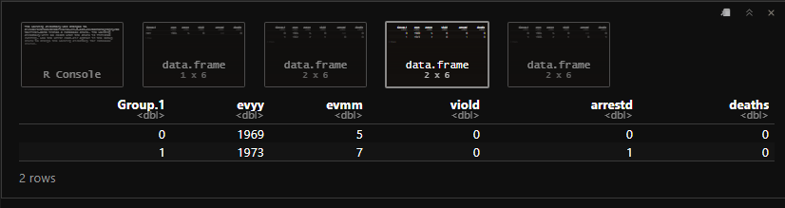
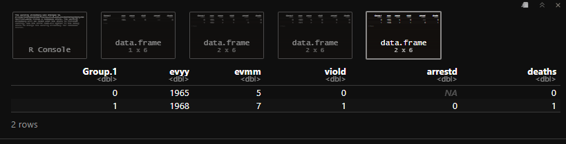
Preliminary Numbers
Notes:
Before any analysis or visualization, here’s a more back-end look at the data. On the left, the top 25 cities by population and their respective number of recorded demonstrations. Obviously, the numbers drop off extremely quickly after New York and Washington D.C., so for future reference, all the log scales in further visualizations try to account for this fact. On the right, there are some breakdowns of the data by year that brought up some interesting trends. First, in the top right, we see the heaviest protest year is 1965. This makes sense given the Vietnam and the Civil rights movements getting into full force. In the remaining three blocks, you can see the most protests involving violence, arrests, and deaths. What’s very interesting about these numbers is how clear the peaceful movement era can be seen. The top year for both non-violence and lack of death is 1965, while arrests lag slightly behind in 1969. The most violence and death was in 1967 and 1968, while again, the most arrests lagged to 1973. This pattern is very interesting because of how clear and consistent the divides are. A weird trend is the if you notice the months. May and July appear to be heaviest for protest, and May is far more peaceful than July. I would be interested to talk to a more history-savvy person to see if there’s perhaps a pattern with civil unrest in certain times of the year.

Slide 5
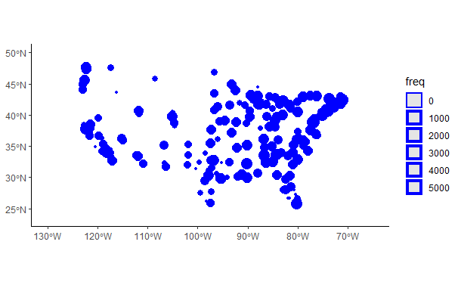
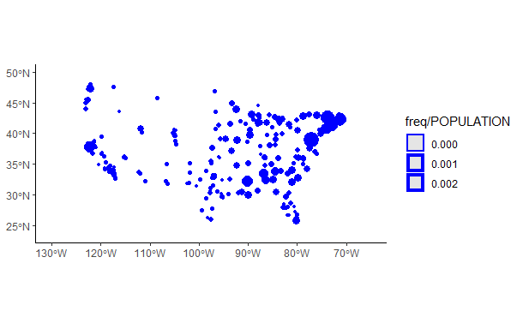
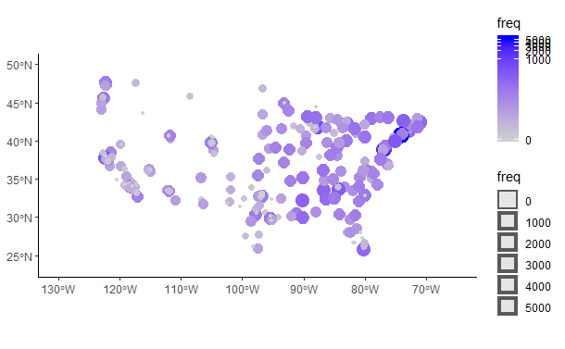
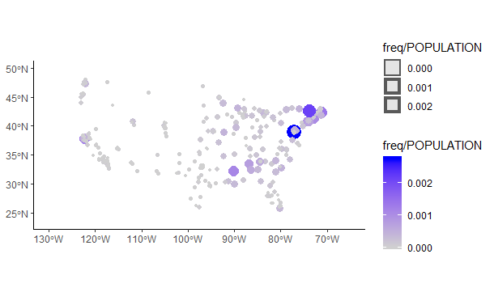
Demonstration Frequencies
Notes:
These maps represent frequencies of demonstrations in cities with a population greater than 10000 (notable cities). On the top, the map is a preliminary size map with no color gradient, while the bottom has a scale equal to the size for the color. The maps on the left represent the raw number of frequency of demonstrations for each city using a log scale, while those on the right represent per capita, with no log scale, as to see the outliers more clearly. Nothing too surprising here, protests are concentrated on the coasts, and especially on the east coast and the south.

Slide 6
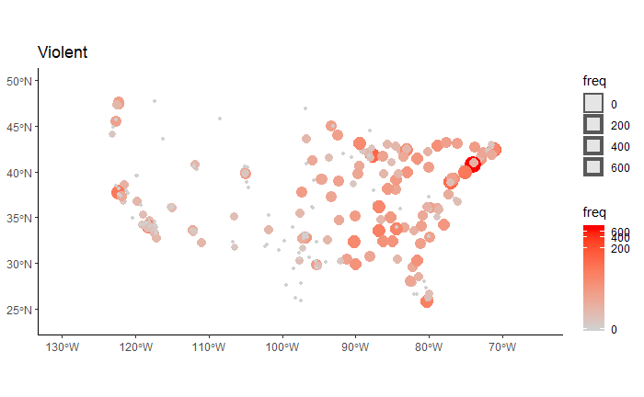
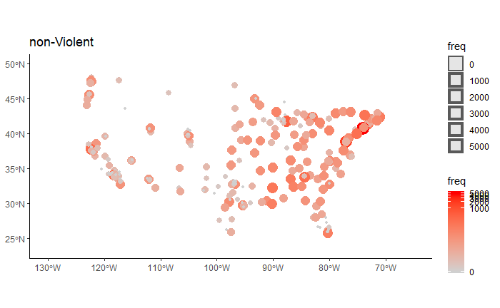
Violence
Notes:
At first pass, most people would guess that violent and non-violent protests would be somewhat regional, but that doesn’t appear to be the case. Looking at these maps, one can see that the violence is only very slightly skewed towards the coasts and the south. This is interesting because regions in the United States tend to represent much greater implications, like political party, income, race, and even broader, culture. In some ways, it’s refreshing to see so little correlation between violent demonstration and any certain group of people. Now, although it’s not a strong correlation, there are definitely more non-violent demonstrations in the midwest, but given that very few civil movements have occurred there, this makes perfect sense.

Slide 7
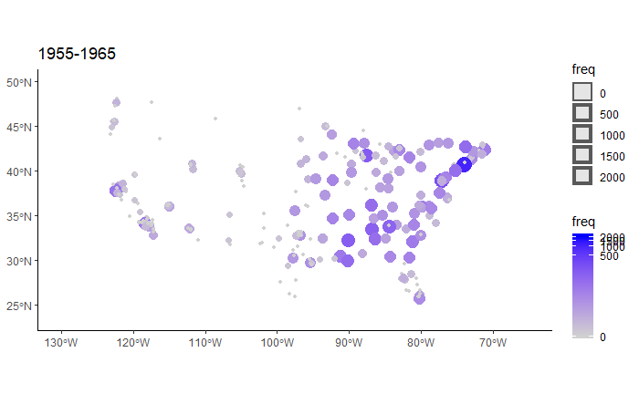
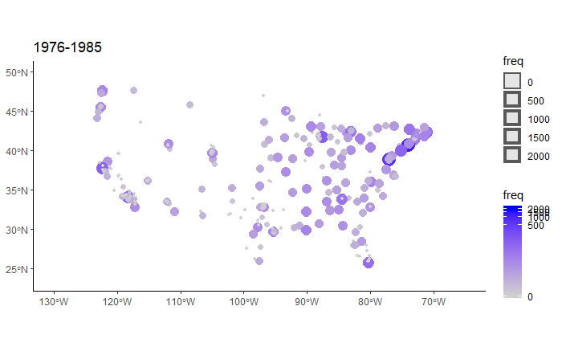
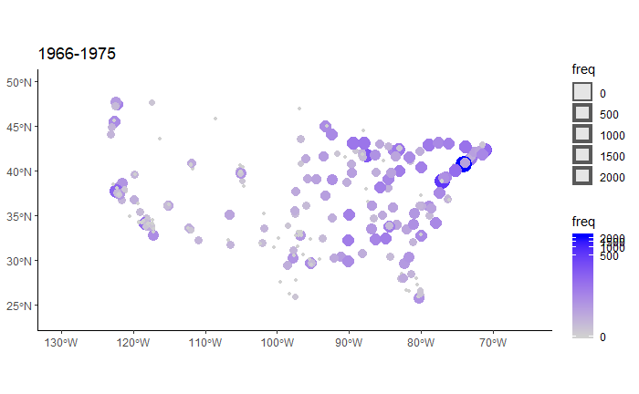
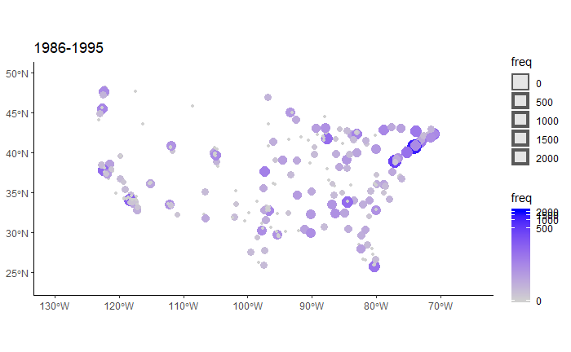
By Decade
Notes:
Next, the difference in the four decades mentioned in the beginning (1965-1995) is interesting, but not too surprising. In the late 50s and early 60s, segregation protests were occurring up until it was outlawed at the end of this period in 1964. Notice the preponderance of protests in the south in this decade compared to the others. Additionally, notice from 66-75 the concentration on the coasts and north. Vietnam protests at this time were decidedly more of a coastal liberal issue, so that can certainly explain what we see on this map. In the next two, the demonstrations are less, and from 86 to 95, decidedly more spread out. I would be interested to see possibly what events were being protested, but no specific regional ones come to mind.

Slide 8
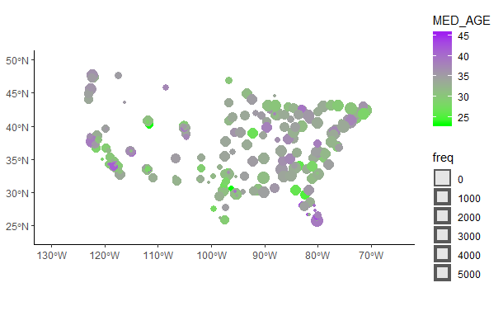
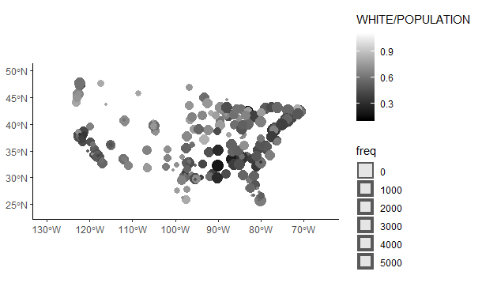
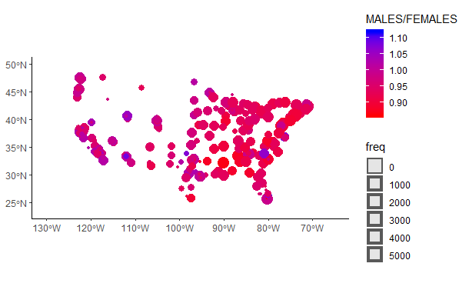
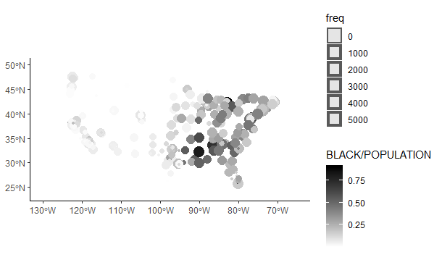
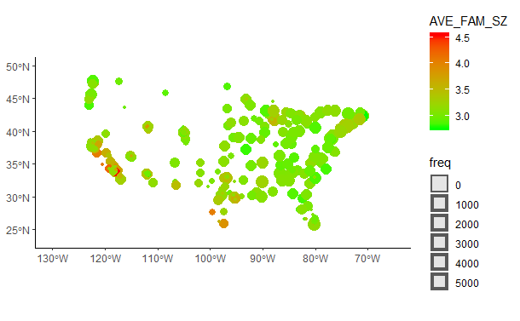
Investigating Demographic Trends
Notes:
Age, gender, income, and race are all important factors to consider with protest data, but after investigation, there wasn’t as much correlation as expected. These maps show the color gradient of the factor being investigated, and the size of the demonstrations’ frequency. To start, median age simply seems more regional than anything else. There are large and small purple dots, and large and small green ones. For gender, I was surprised at the strength of the correlation. The cities with higher female populations certainly seem to have more protests, however, this may just be due to the location of the cities, with very little causation. Average family size was supposed to be a measure of income, because income data didn’t integrate well with this dataset, but upon investigation, it seems to have a more random and regional distribution. For both race maps, it seemed that there were very few heavily white cities that protested a great deal, but little correlation outside of that.

Slide 9
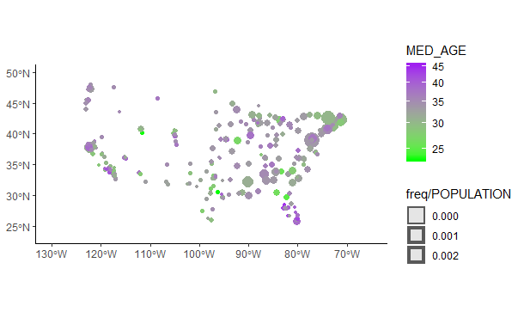
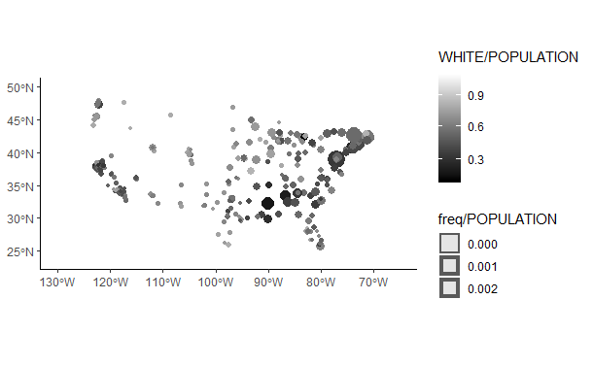
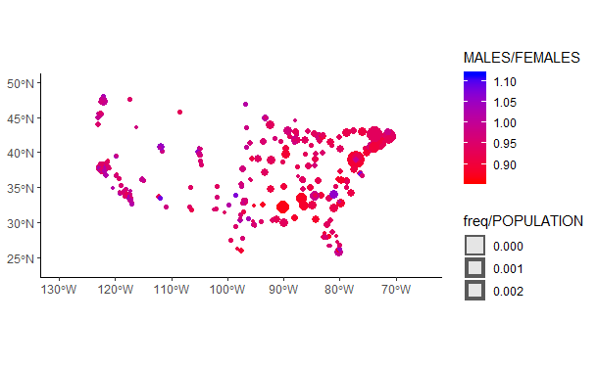
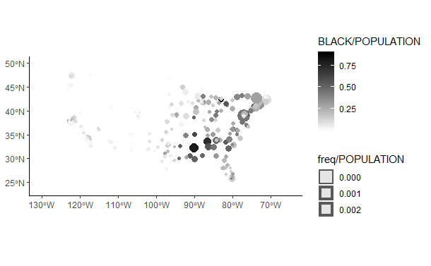
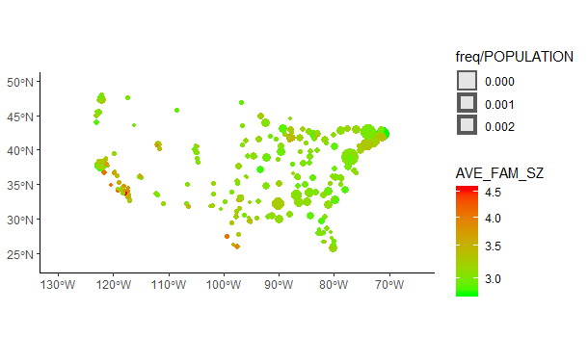
Per Capita Adjustments
Notes:
When adjusting these numbers to a per capita scale, correlations definitely became more clear. Age and average household remained uncertain, so it is reasonable to claim that there isn’t much of a relationship. Gender was very interesting. When adjusting per person, we see that all the major protest cites are very red. I would be interested to see if this relationship is due to city size or more female cities actually tending to demonstrate more. With race, a similar result, especially on the WHITE/POPULATION map. We can see that all the biggest protest sites are dark grey or black. That being said, it could also be the bigger cities are simply more diverse.

Slide 10
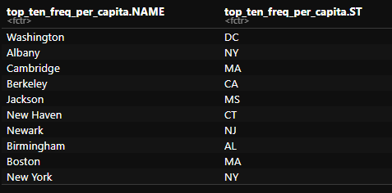
Conclusions
No perfect way
Region
Decade
Notes:
There is obviously no perfect way to predict protests. Based on this research, it seems that the best way is to look at region and time, which makes sense. Factors like demographics do seem to be correlated with frequency of protests, but not in a meaningful enough way that given demographic data of a city, we can predict protests. A useful conclusion, however, is that if we see a city’s past protests, it tends to stay pretty equal over time, scaled for national frequency. The ten cities on the right are the ones that protest the most per capita, and honestly there aren’t any surprises.

Slide 11
Problems With Data and Possible Improvements
Size of data
More demographics
Possibly different visualizations
Notes:
This dataset is good, but everything can be improved. Originally, I had wanted to compare individual cities more, and while this can be done, I decided not to throw a ton of numbers with very little resulting conclusion into this presentation. Unfortunately, the size of the data is very limiting. For example, Boston has only 473 protests. Nationally, however, this dataset is ideal, because it shows trends with ease. Ideally, given an infinite timeline, I could have incorporated more demographic data from many different sources, but integrating data correctly proved very difficult, and resulted in many good datasets not being used. Lastly, someone better with R could certainly do more visually informative and more interactive visualizations. For examples, perhaps a per-year map, or a dynamic map that changes over time.

